Slide 1
Developing Integration Solutions using Microsoft BizTalk Server 2016
Schemas

Slide 2

Course Outline
Module 1: Introduction to BizTalk Server
Module 2: Schemas
Lesson 1: Introduction to BizTalk Schemas
Lesson 2: Creating XML and Flat File Schemas
Module 3: Maps
Module 4: Testing and Deploying Projects
Module 5: Pipelines
Module 6: Routing
Module 7: Adapters
Module 8: Web Services and WCF
Module 9: Introduction to Orchestrations
Module 10: Applied Orchestration Techniques
Module 11: Business Activity Monitoring
Module 12: Integrating Business Rules
Module 13: Deploying and Managing Applications
Extra modules

Slide 3
Lesson 1: Introduction to BizTalk Schemas
Reviewing XML Terminology
What Are XML Namespaces?
What is a MessageType and how is it used?
What Is a BizTalk XML Schema?
Supported BizTalk Schema Types
Flat File Structures
Schema re-use

Slide 4
Reviewing XML Terminology
XML Syntax
Namespaces in XML (xmlns)
Elements
<element1></element1>
Attributes
<element1 attrbute1=”value1>text1</element1>
XML standards used in BizTalk
XML Schema (XSD)
Extensible Stylesheet Language Transformations (XSLT)
XML Path Language (XPath)
Web Services Description Language (WSDL)
Simple Object Access Protocol (SOAP)
Notes:
■ Namespace. An XML namespace is a W3C standard for providing uniquely named
elements and attributes in an XML instance. An XML instance may contain
element or attribute names from more than one XML vocabulary. If each
vocabulary is given a namespace, the ambiguity between identically named
elements or attributes can be resolved.
■ Element. An XML element is a construct used to organize information in a
hierarchical manner. XML elements can either be simple data types (such as
strings, decimals, and unsigned bytes) as defined in W3C standards, or they may
be a complex type containing other elements and/or attributes. Elements and
attributes are case sensitive; that is, Customer is not the same element name as
customer or CUSTOMER.
■ Attribute. An XML attribute is a construct used to associate additional information
contained with an XML element. Unlike elements, attributes cannot be nested.
Attributes can be associated with any of the simple data types, but because they
cannot be nested, they cannot be a complex type.
■ In the following example, Customer is an element with a value of Contoso. ID is an
attribute of the Customer element and has a value of 12345.
<Customer ID=“12345”>Contoso</Customer>
XML Schema Definition Language (XSDL). The XML schema definition language is
used to create schemas that represent the message formats that BizTalk will
process. Schemas define nodes such as required and optional fields, recurring
fields, and order. An instance message can be validated against an XSD to verify
that the format is valid.
■ XML Path Language (XPath). A language used for navigating through the hierarchy
of an XML document. For example, XPath can be used to select data in an XML
document that matches a certain criterion or to perform comparisons on retrieved
data.
■ Extensible Style Sheet Language Transformation (XSLT). A language definition for
XML data presentation and data transformations. Data presentation refers to how
data is formatted for display purposes in a specific format or style. Data
transformation refers to how data is transformed and exchanged. For example, a
purchase order could be converted from the format submitted by a trading partner
to the format required for your internal processes.
■ Document Object Model (DOM). The DOM provides a mechanism for navigating
through a message. When working with XML documents, the DOM is often used
to manipulate and query XML data. In BizTalk, when references are made to the
XML DOM, it is usually presumed that the message is being loaded into memory,
which results in slower processing than would be experienced if the data were
simply being streamed.
■ Web Services Description Language (WSDL). An XML format that describes the
capabilities and characteristics of a Web service. BizTalk can both publish and
consume Web services. That will be discussed in module 12.
■ Simple Object Access Protocol (SOAP). Defines a simple way of sending XML
messages across the Internet. SOAP is used in BizTalk Server in conjunction with
Web services.

Slide 5

What Is a BizTalk XML Schema?
<xs:schema xmlns="http://bLogical.RssFeed"
targetNamespace="http://bLogical.RssFeed"
xmlns:xs="http://www.w3.org/2001/XMLSchema">
<xs:element name="RssFeed">
<xs:complexType>
<xs:sequence>
<xs:element name="Title" type="xs:string" />
<xs:element name="Link" type="xs:string" />
<xs:element name="Author" type="xs:string" />
<xs:element name="PubDate" type="xs:dateTime" />
<xs:element name="Description" type="xs:string" />
</xs:sequence>
</xs:complexType>
</xs:element>
</xs:schema>
BizTalk uses the XML schema definition language (XSD)
XML schemas define the data structure for all XML business documents
BizTalk requires schema definitions to be deployed in order to recognize the Messge Type.
Attribute
Element
<Invoice>
<Customer ID="1234">
<Name>Kramerica Industries</Name>
...
</Customer>
<InvoiceRows>
<InvoiceRow>
...
</InvoiceRow>
</InvoiceRows>
</Invoice>
Elements
<ns0:RssFeed xmlns:ns0="http://bLogical.RssFeed">
<Title>BizTalk Rocks!</Title>
<Link>http://bLogical.se/blogs/wmmihaa/biztalk_rocks.aspx</Link>
<Author>Mikael Håkansson</Author>
<PubDate>2010-05-31T13:20:00.000-05:00</PubDate>
<Description>bla bla bla</Description>
</ns0:RssFeed>

Slide 6
What Are XML Namespaces?
Provide unique names for elements and attributes
Prevent naming conflicts with other schemas
Use the xmlns attribute to declare the namespace the element belongs to
A prefix is added to the declaration to remove ambiguity
<xs:schema targetNamespace="http://bLogical.Order"
xmlns="http://bLogical.Order"
xmlns:xs="http://www.w3.org/2001/XMLSchema"
xmlns:nsCustomer="http://bLogical.Customer">
<xs:import schemaLocation=".\customer.xsd"
namespace="http://bLogical.Customer" />
<xs:element name="Order">
<xs:complexType>
<xs:sequence>
<xs:element name="OrderID" type="xs:string" />
<xs:element name="OrderDate" type="xs:string" />
<xs:element ref="nsCustomer:Customer" />
<xs:element name="OrderRows">
<xs:complexType />
</xs:element>
</xs:sequence>
</xs:complexType>
</xs:element>
</xs:schema>
<ns0:Order xmlns:ns0="http://bLogical.Order">
<OrderID>1234</OrderID>
<OrderDate>2010-01-01</OrderDate>
<ns1:Customer xmlns:ns1="http://bLogical.Customer">
<Name>Logica</Name>
<OrgNr>564783-2121</OrgNr>
</ns1:Customer>
<OrderRows />
</ns0:Order>

Slide 7
What is a BizTalk MessageType?
MessageType is the combination of targetnamespace#rootnode
<ns0:Order xmlns:ns0="http://bLogical.Order">
<OrderID>1234</OrderID>
<OrderDate>2010-01-01</OrderDate>
<ns1:Customer xmlns:ns1="http://bLogical.Customer">
<Name>Logica</Name>
<OrgNr>564783-2121</OrgNr>
</ns1:Customer>
<OrderRows />
</ns0:Order>
http://bLogical.Order#Order
Notes:
Explain a little bit about how a MessageType is vital in BizTalk and examplify why.

Slide 8
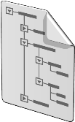


How Does BizTalk Use XML Namespaces and MessageTypes?
<ns0:Order xmlns:ns0="http://bLogical.Order">
<OrderID>1234</OrderID>
<OrderDate>2010-01-01</OrderDate>
<ns1:Customer xmlns:ns1="http://bLogical.Customer">
<Name>Enfo Zystems</Name>
<OrgNr>564783-2121</OrgNr>
</ns1:Customer>
<OrderRows />
</ns0:Order>
XML Disassembler
Söker efter namespace
och sätter MessageType
MessageType = http://bLogical.Order#Order
MessageBox
Notes:
It should be noted that BizTalk can process strictly binary data—for example, .bmp files
and .pdf files through its routing functionality—from one location to another, and, in this
case, an XML schema is not required. This special handling requires the use of a passthrough pipeline, which will be addressed in Module 5

Slide 9
Supported BizTalk Schema Types
Schema Type | Details
 | Supports native XML message types Defined in XML Schema definition language (XSD)
 | Supports delimited or positional file formats XML tags used to represent values Tag information stored using the annotation capabilities of XSD
UNA:+.? ' UNB+UNOC:3+123456789:ZZ+987654321:ZZ+090804:0758+491944' UNH+464009+APERAK:D:07B:UN:2.0b' BGM+313+464009' DTM+137:201008040758:203' RFF+ACE:100048193285' DTM+171:201008040606:203' | Specially formatted text message BizTalk supports EDIFACT and X12 formats XSD annotations used to define format
XML
<ns0:RssFeed xmlns:ns0="http://bLogical.RssFeed">
<Title>BizTalk Rocks!</Title>
<Link>http://bLogical.se/blogs/wmmihaa/</Link>
<Author>Mikael Håkansson</Author>
<PubDate>2010-05-31</PubDate>
<Description>bla bla bla</Description>
</ns0:RssFeed>>
Flat file
BizTalk Rocks!;http://bLogical.se/;Mikael;2010-05-31;bla bla bla
EDI

Slide 10
Other common file formats supported by BizTalk
File Type | Details
{ "Customer": { "firstName": “John", "middleName": “Alan", "lastName": “Doe", "phoneNumber": “555-345-876" } } | JavaScript Object Notation format A “modern” format than XML Considered more compact, more readable and more interoperable than XML NOTE: There are no “JSON Schemas” in BizTalk.
Whatever else interpretable that you can write code to interpret into XML is possible, but no out of the box capabilities exists. | Binary formats Specific application formats NOTE: These are most often not handled by ”schemas”, but instead handled by ”adapters”. Something we will talk more about later.
JSON
Other

Slide 11
Flat File Structures
Delimited flat files
Fields separated by a specified delimiter
Have a common end-of-record terminator
Positional flat files
Fields are fixed length
Have a common end-of-record terminator
BizTalk Rocks!;http://bLogical.se/bts;Mikael;2010-05-31;bla bla bla
WCF Rulez!;http://bLogical.se/wcf;Mikael;2010-06-02;bla bla bla
Azure is LOVE!;http://bLogical.se/azure;Mikael;2010-06-02;bla bla bla
BizTalk Rocks! http://bLogical.se/bts Mikael 2010-05-31 bla bla bla
WCF Rulez! http://bLogical.se/wcf Mikael 2010-06-02 blaa bla bla
Azure is LOVE! http://bLogical.se/azure Mikael 2010-06-02 bla bla bla

Slide 12
EDI File Structures
Delimitations
ComponentDataElementSeparator = “:”
ElementSeparator = “+”
RepetitionSeparator = “*”
SegmentTerminator = “ ‘ “
UNA:+.? ' UNB+UNOC:3+123456789:ZZ+987654321:ZZ+090804:0758+491944' UNH+464009+APERAK:D:07B:UN:2.0b' BGM+313+464009' DTM+137:201008040758:203' RFF+ACE:100048193285' DTM+171:201008040606:203' NAD+MS+123456789::ZZ' NAD+MR+987654321::ZZ' ERC+Z06' FTX+ABO+++9904383000003' RFF+ACE:100048193285' UNT+11+464009' UNZ+1+491944'

Slide 13
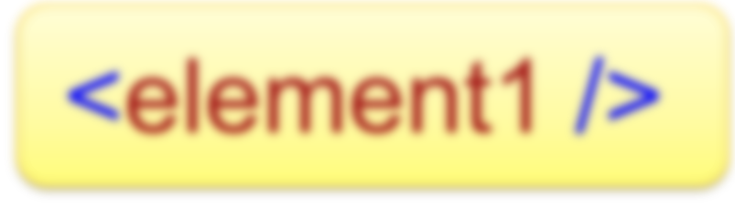
Processing Message
BizTalk can route any content!
But…
Only process XML!
Notes:
Explain that the definition of process is to map or to extract data from, alter data in or insert data into a message.

Slide 14
Using Multiple Schemas
<xs:import>
allows you to use schema components from any schema
<xs:include>
adds the schema components from other schema documents that have the same target namespace (or no specified target namespace)
<xs:redefine>
the redefined components become part of the redefining schema's target namespace
Order
<
>
OrderID
<
>
OrderDate
Customer
Customer
Rows
<
>
CustomerID
OrderRow
<
>
Name
Addresses
Address
Contacts
OrderRow
Person
<
>
ProductID
<
>
Name
<
>
Qty
<
>
Price

Slide 15
Lesson 2: Creating XML and Flat File Schemas
Methods for Creating BizTalk XML Schemas
Testing and Validating Schemas
Demonstration: Creating and Testing a Schema
Using the Flat File Schema Wizard
Demonstration: Creating and Testing a Flat File Schema
Building a BizTalk Project

Slide 16
Methods for Creating BizTalk XML Schemas
Schema creation methods
Create from scratch using BizTalk Editor
Create from scratch using Flat-file wizard
Import or include existing types
Generate from adapter metadata
Generate from an instance message

Slide 17
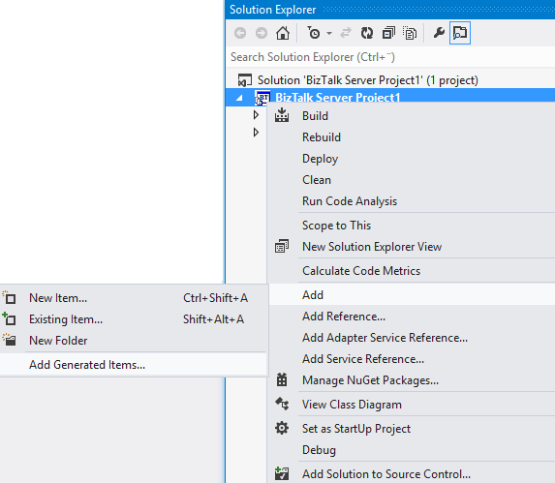
Generating Schemas – Add Generated Items
Schema generation methods
XDR schema (BizTalk 2002)
DTD
A well-formed XML instance message

Slide 18
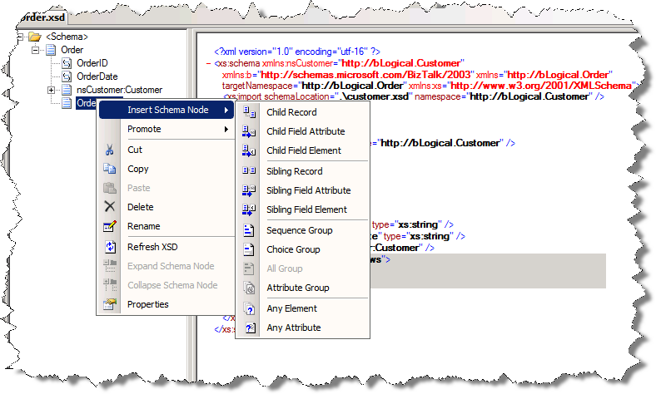
Creating a Schema by Using the BizTalk Editor
XSD view
Schema
tree view

Slide 19
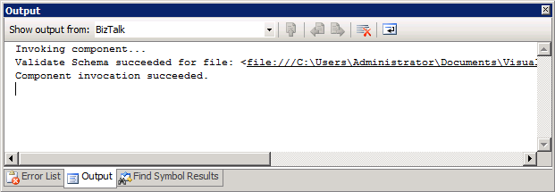
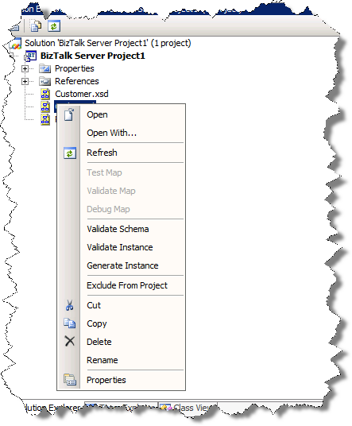
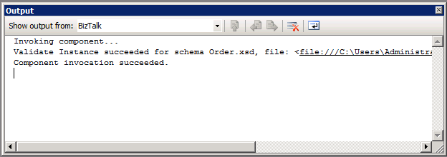
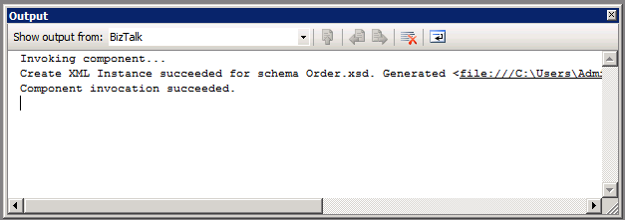
Testing a Schema
Validate Structure
Validate Data
Generate Data

Slide 20

Demo
Create a Schema using the BizTalk Schema Editor in Visual Studio
Validate and test schema
Notes:
(slide 18)
Open Visual Studio .NET 2008
Open the solution at: C:\Demos\Mod2\Start\Mod2Demo1.sln
Create a schema, name it Customers
Name the root Customers, insert a child record Customer
Use 4 elements:
FirstName, MiddleName, LastName, ContactNo.
Tell students about the context menu and using shortcuts
Menu i, e (insert child element)
Menu, i, l (insert sibling element) ... and so on ...
Open and show C:\Demos\Mod2\Start\Customers.xml
Use it to Validate Instance of the schema

Slide 21
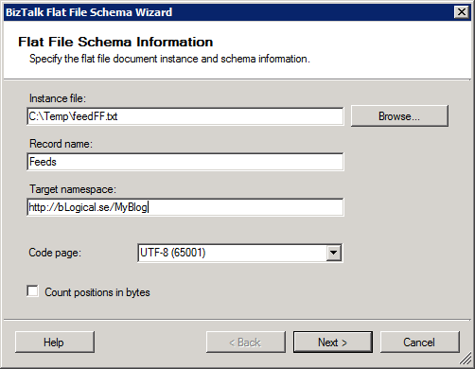
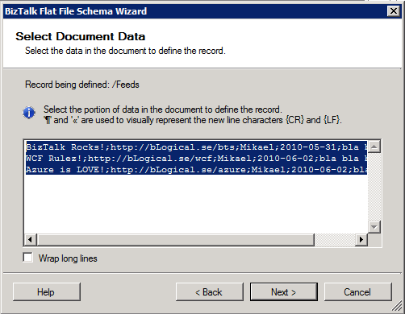
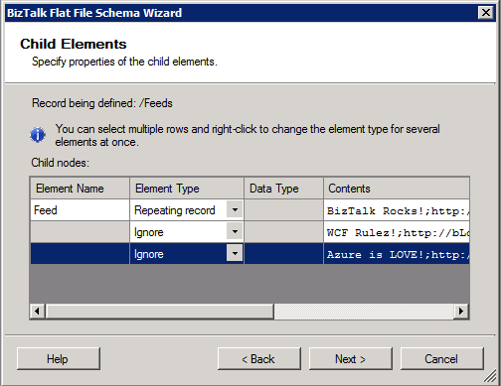
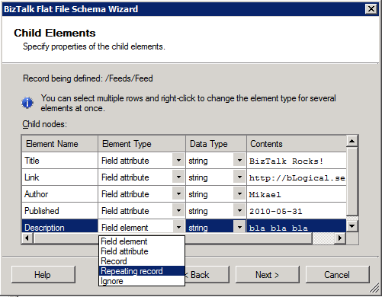
Using the Flat File Schema Wizard
Flat File Schema Wizard
Graphical tool for defining flat file schemas
Can define schemas for delimited or positional flat files

Slide 22
Demo
Create a schema by using the Flat File Schema Wizard
Validate and test schema
Notes:
(slide 20)
Select the project. Add – New Item.
Flat File Schema Wizard.
Name the root node Customers.
Select C:\Demos\Mod2\Start\Customers.txt
First pass: Select all. Delimiter CR LF. Customers.
First row: Repeating Record, Customer, Second row: Ignore .
Second pass: Select first row without CR LF. Delimiter ”,” (comma)
Elements: FirstName, MiddleName, LastName, ContactNo.
Validate instance will have been set to selected file.
Validate the instance.

Slide 23
Summary
Schemas are used to describe XML Files.
BizTalk Server has annotations that describes flat files (text files).
Wizards can help you create schemas from flat files.
BizTalk allows you to use Visual Studio to build and validate XML and flat files against their schemas, as well as create sample files conforming to the schema.

Slide 24
Q & A
Schemas

Slide 25


Hands-On-Labs
Working with Schemas
Create a new BizTalk project
Create an XML schema using the BizTalk Editor
Promote a schema property.
Create a flat file schema by using the BizTalk Editor.
Validate a schema and generate a sample instance message.
Create a strong name and assign it to an assembly.
Build a schema project.

Slide 26

Quiz
What are the two main building blocks in schemas?
What two types of delimitation does BizTalk support in flat files?
How can you re-use schemas?

